Slide 1
Live Streaming and Disability: Reconfiguring Play on Twitch.tv
Mia Consalvo & Roger Altizer

Slide 2
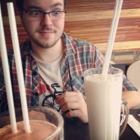
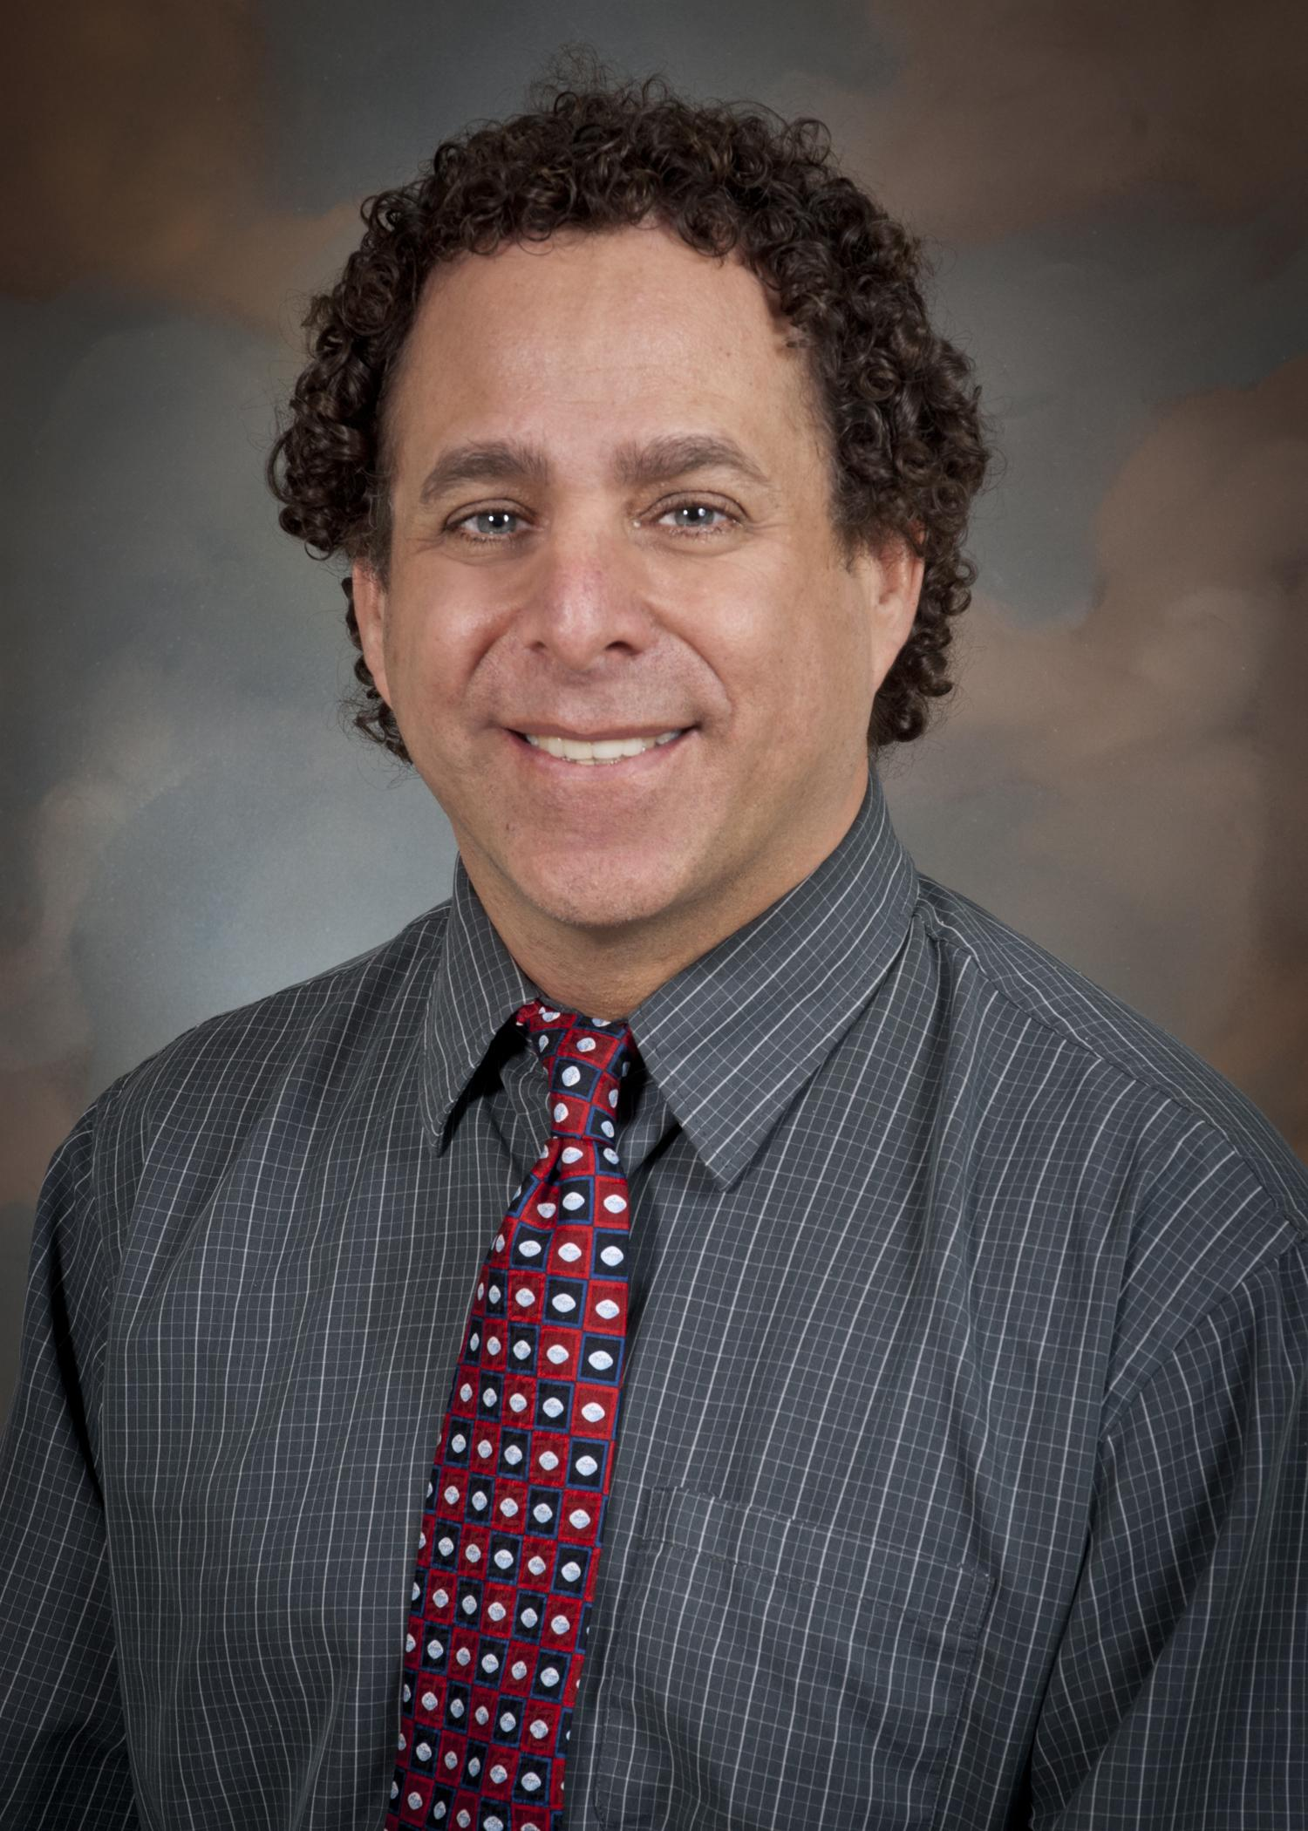
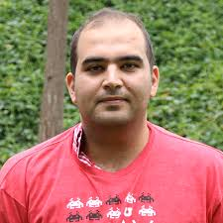
Shoutout To ...
Marc Lajeunesse, Andrei Zanescu, Dr. Rosenbluth, Jesse Ferraro, Ahmad Asaleem

Slide 3
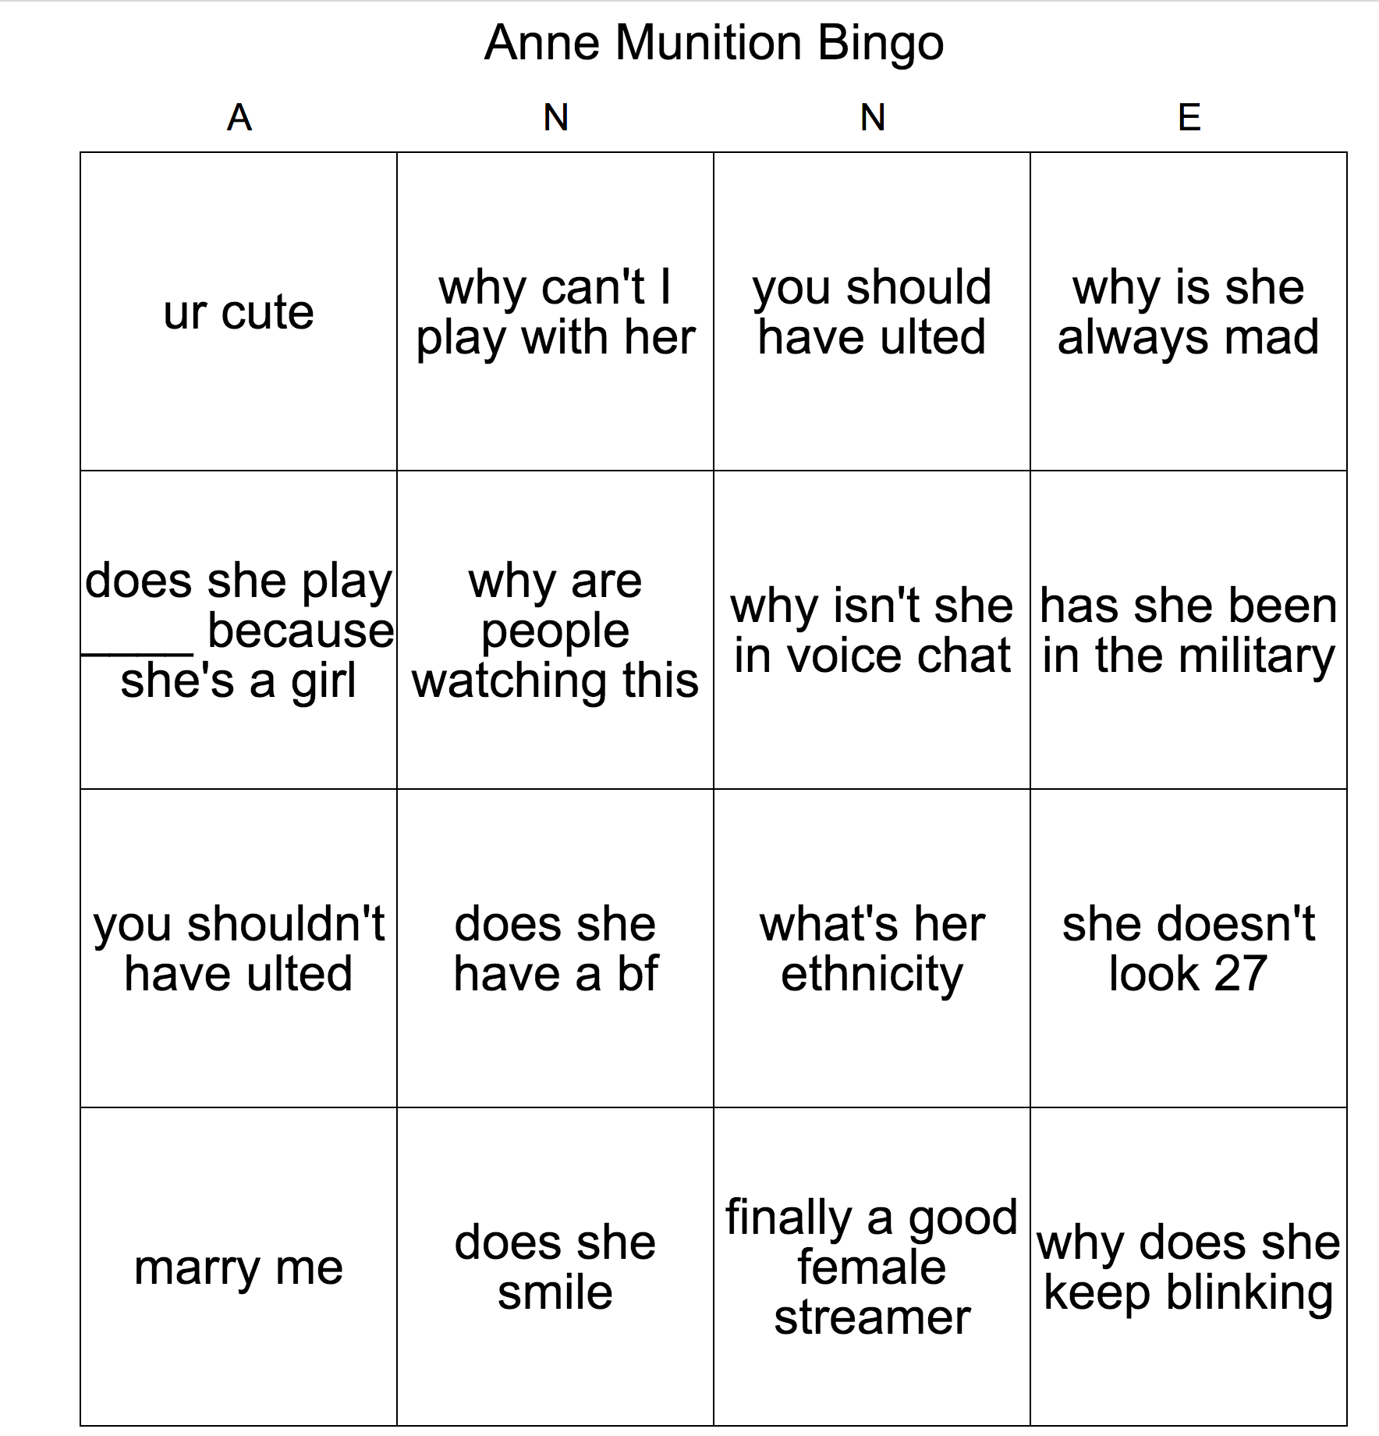
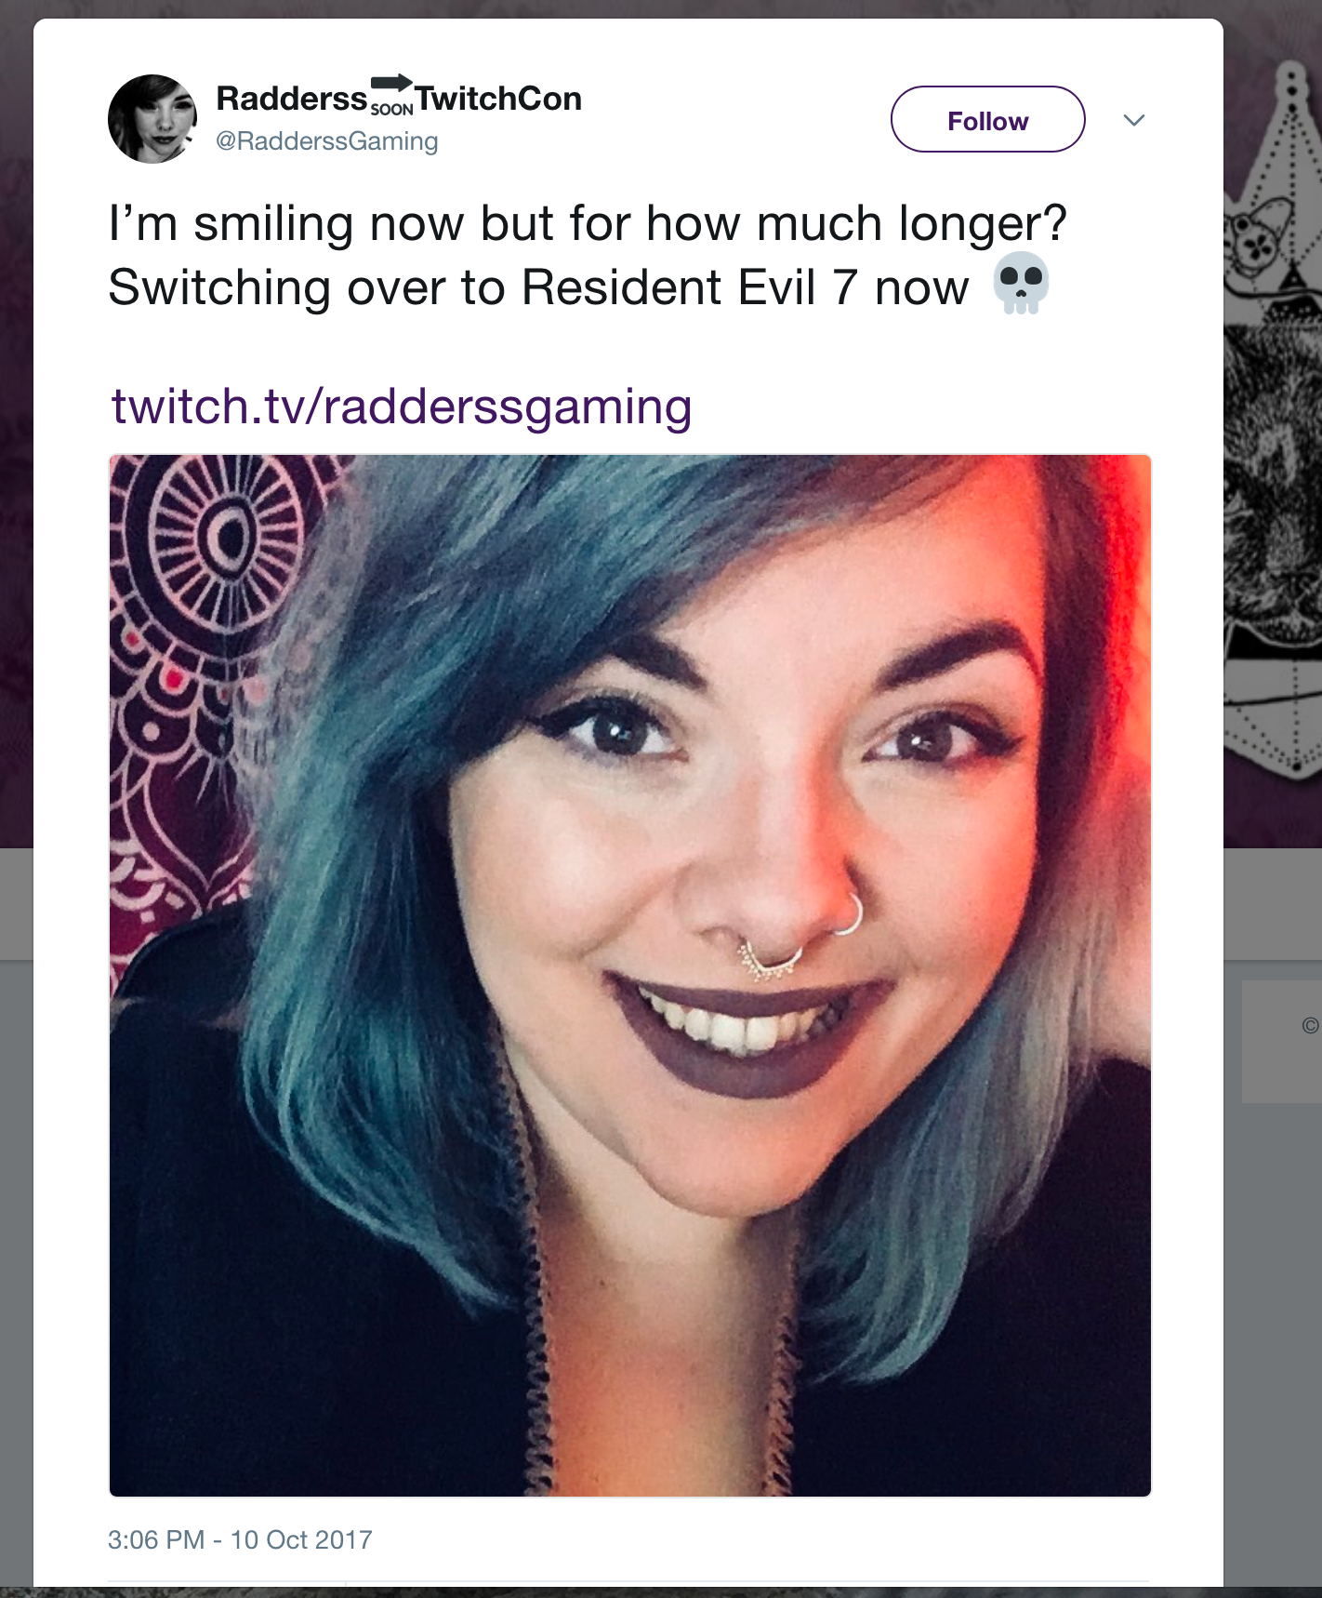
Mia - streaming @ the margins of play

Slide 4
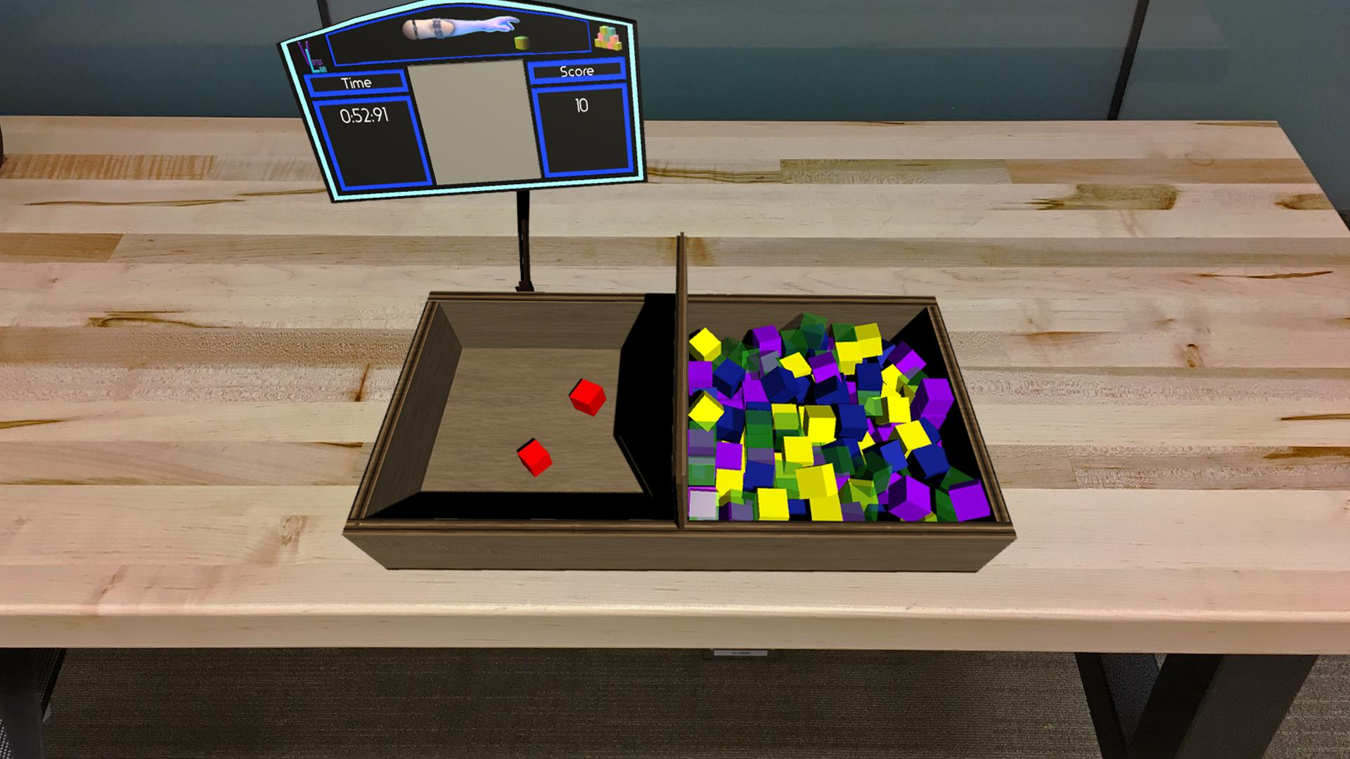
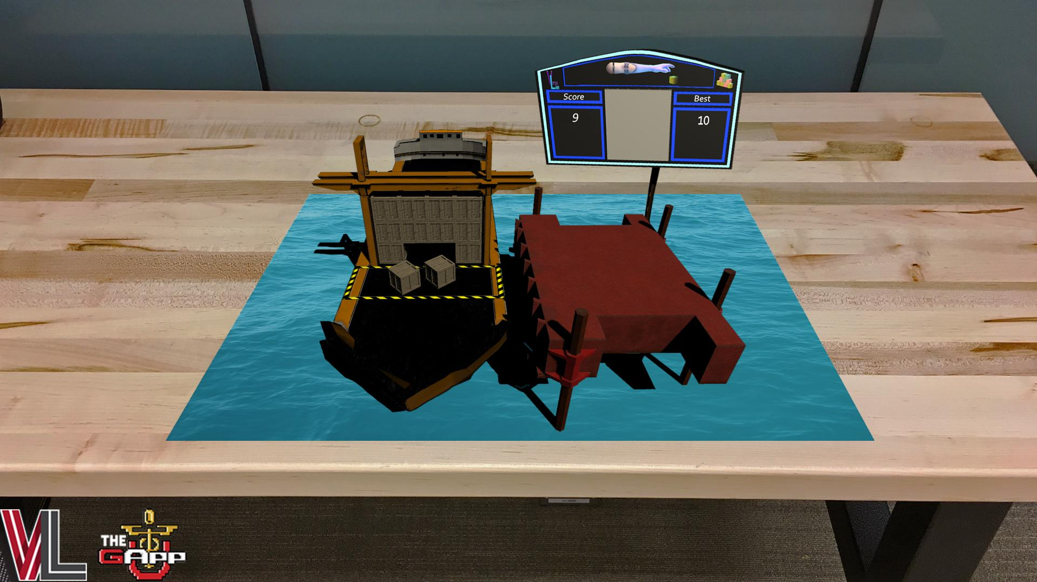
Roger - Playful Augmentation

Slide 5
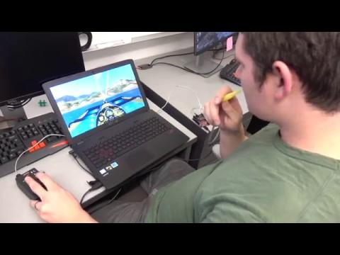
Roger - Sipping, Simulating…

Slide 6
Roger - … and Sailing

Slide 7
literature/theory: streaming and play
TL Taylor (we’re eagerly awaiting the book TL!)
Smith, Obrist & Wright (2013) detailed 3 main Twitch communities- eSports, speedrunners, Let’s Players (Variety)
Hamilton, Garreton & Kerne (2014) investigate live streaming as a ‘third place’ for fostering participation and community
Consalvo & Sugiarto (2016) study failure as it is performed and understood by streamers and their viewers/communities

Slide 8
literature/theory: disability theory and practice
Carr, Diane. "Ability, disability and dead space." Game Studies 14, no. 2 (2014).
Carr, Diane. "Constructing disability in online worlds; conceptualising disability in online research." In Reinventing Ourselves: Contemporary Concepts of Identity in Virtual Worlds, pp. 177-190. Springer London, 2011.
Halton, Jonathan. "Virtual rehabilitation with video games: A new frontier for occupational therapy." Occupational therapy now 9, no. 6 (2008): 12-14.

Slide 9
literature/theory 2: disability theory and practice
Biddiss, Elaine, and Jennifer Irwin, “Active video games to promote physical activity in children and youth: a systematic review.” Archives of pediatrics & adolescent medicine 164, no. 7 (2010): 664-672.
Donna Davis & Tom Boellstorff, “Compulsive Creativity: Virtual Worlds, Disability, and Digital Capital” International Journal of Communication (2016)
Notes:
Reminds us of the discourse about Second Life and people with disabilities - a place where they can overcome isolation; possibly make community, overcome limitations, make money (liberatory discourses); here applied to people with Parkinson’s and an effect of the disease that they believe is expressed in SL
Elcessor - Catfish documentary and television show and the portrayals of people with disabilities and how/why they are hidden. Reminds us of the figure of “Joan” from early cyberlore. We stilll don’t theorize/understand disabilty experiences in relation to new media that well.

Slide 10
Reconfiguring technospaces
Elizabeth Ellcessor, “Cyborg Hoaxes: Disability, deception, and critical studies of digital media” New Media & Society (2016)
*Users with disabilities often actively involved in reconfiguring their technoscapes to make them more usable
*Disability as lens to interrogate normative forms of digital media & ideological structures that maintain and challenge them
Notes:
Reminds us of the discourse about Second Life and people with disabilities - a place where they can overcome isolation; possibly make community, overcome limitations, make money (liberatory discourses); here applied to people with Parkinson’s and an effect of the disease that they believe is expressed in SL
Elcessor - Catfish documentary and television show and the portrayals of people with disabilities and how/why they are hidden. Reminds us of the figure of “Joan” from early cyberlore. We stilll don’t theorize/understand disabilty experiences in relation to new media that well.

Slide 11
“Misfits”
Rosemarie Garland Thomson, “Misfits: A feminist materialist disability concept” - Hypatia, 2016
“A square peg in a round hole”
The problem “inheres not in either of the two things but rather in their juxtaposition, the awkward attempt to fit them together”
A misfit is a “jarring juxtaposition, an ‘inaccurate fit; (hence) unsuitability, disparity, inconsistency’”
Notes:
Extraordinary Bodies: Figuring Physical Disability in American Culture and Literature (1997)

Slide 12
Disability + Streaming Research Questions 1/2
Who is livestreaming videogames on Twitch?
What is their range of identities and experiences?
What practices do those streamers engage in?
What games do they play, how do they play them, and how do they talk about that gameplay during the act of play?

Slide 13
Disability + Streaming Research Questions 2/2
How do those streaming practices reshape established definitions or understandings of play, both of offline and online games?
How does representations of health and/or disability shape the experience of streamers and audience members?

Slide 14
Methods
*Analysis of popular media discourse on streaming and disability (as compared to medical discourse)
*Observation of multiple live streams (and VODs) (and Twitter) of individuals who identify as having a disability on Twitch.tv during 2017
--Today’s preliminary analysis: focus on 3 streamers

Slide 15
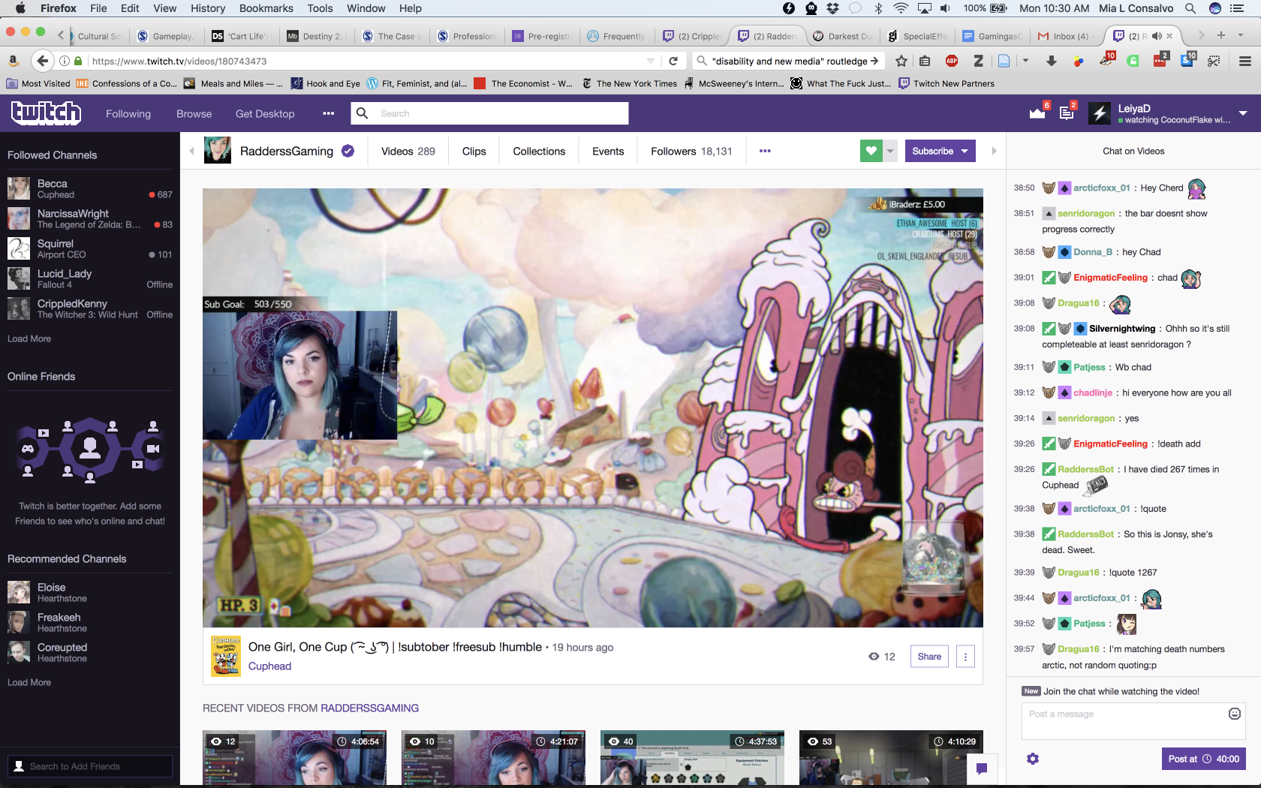
Twitch.tv

Slide 16
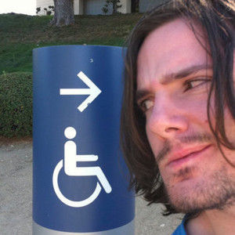
Radderssgaming
Mackenseize
CrippledKenny
18,355 followers
Average audience ~94 viewers
Variety streamer (Resident Evil 7; Cuphead; South Park: Stick of Truth)
36,758 followers
Average audience ~57 viewers
Professional Hearthstone player
5,299 followers
Average audience ~19 viewers
Variety streamer (Witcher 3, Dream Daddy, Hellblade)
Notes:
What is their range of identities and experiences?
All are Partners with Twitch
Radders and Mackenseize will be at TwitchCon later this week in Long Beach

Slide 17
Obsv. 1 Flagging
[How] do people identify as disabled streamers?
**Passing versus self-identifying**

Slide 18
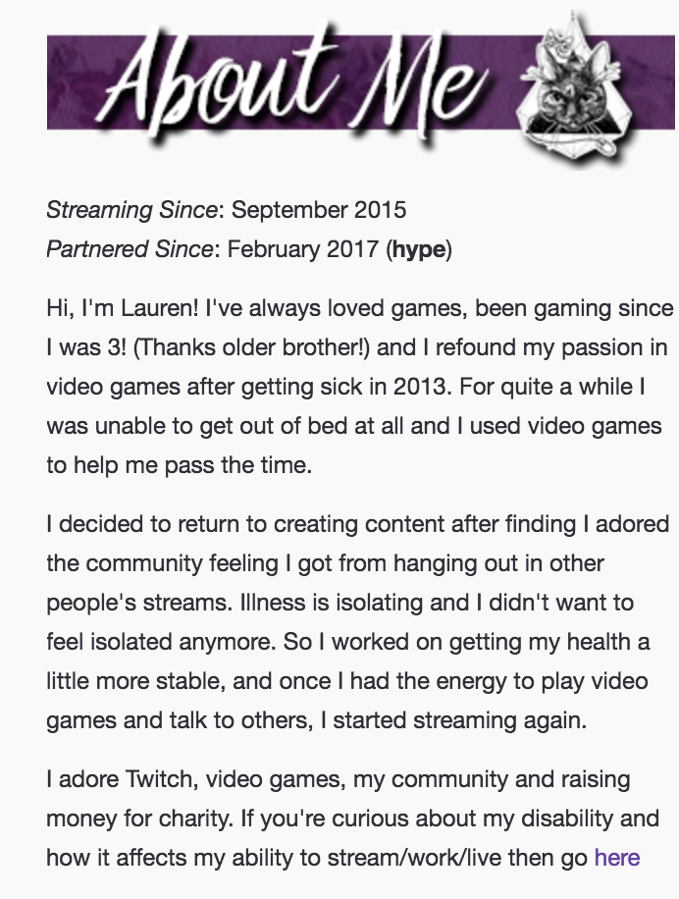
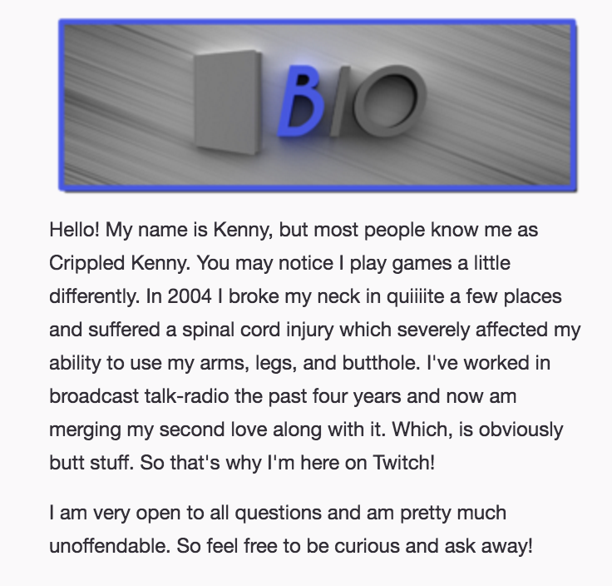
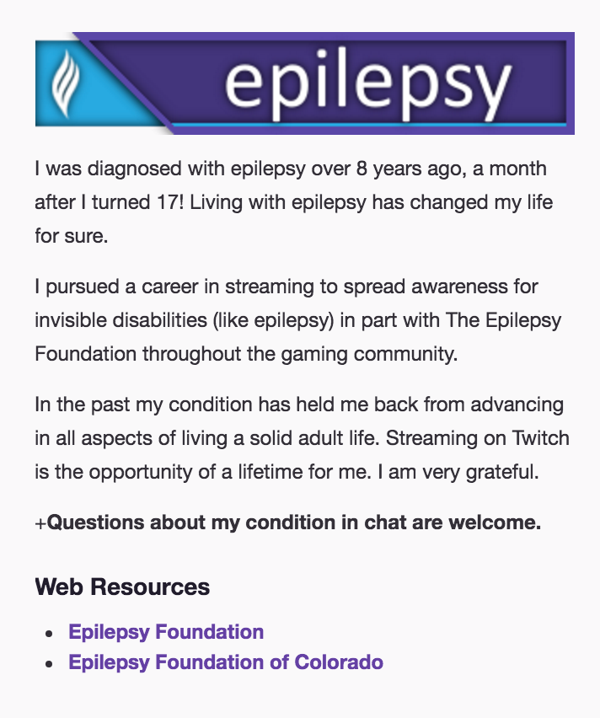

Slide 19
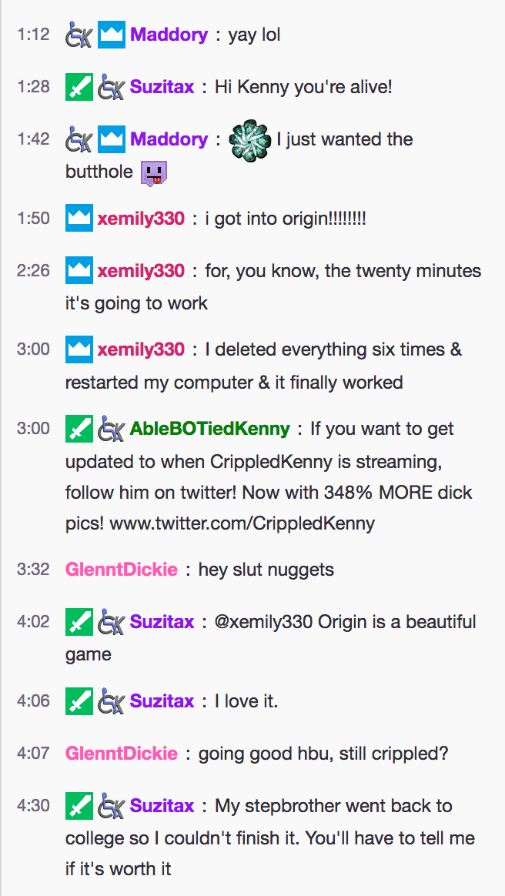
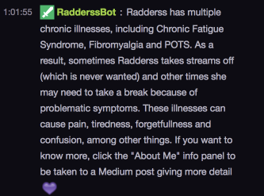
Bots + emoticons - performing an identity

Slide 20
Opening videos
Notes:
CrippledKenny’s opening stream loop.

Slide 21
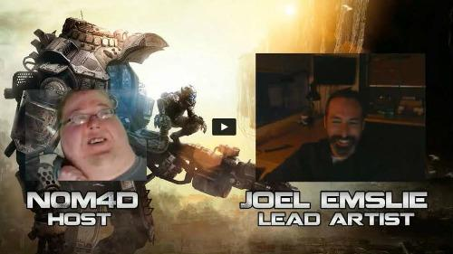
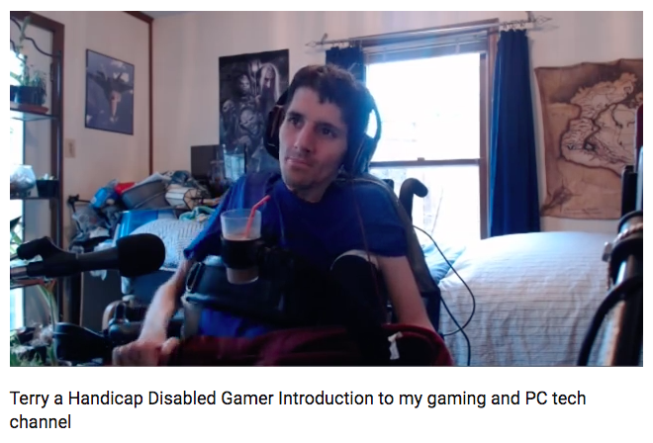
Obsv. 2 Hackers of the World Unite!
Ellcessor - Users with disabilities often actively involved in reconfiguring their technoscapes to make them more usable

Slide 22
Obsv. 3 Mis/fitting and the performance of play
The bulk of streaming focuses on gameplay and social interaction - it fits into what we know of Twitch
**Jump scares during streams of RE7
**Streamer talking about what deck she’s playing
**Streamer fighting as Geralt, but without pants (Geralt, we don’t know about Kenny)

Slide 23
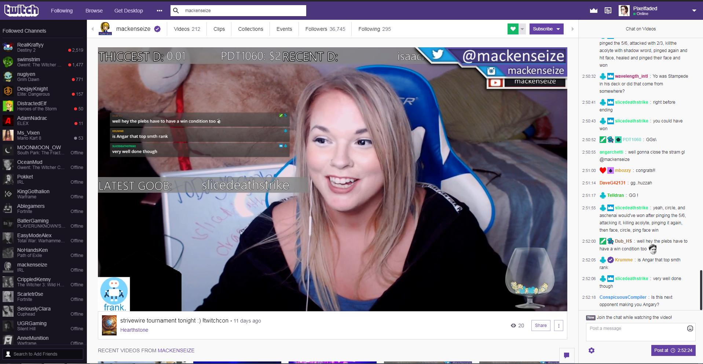
Notes:
19:30 – Discussing clothing choices for TwitchCon and then transition into discussion which decks she’s going to play and the metrics about that.
[sample - pic from a different stream]

Slide 24
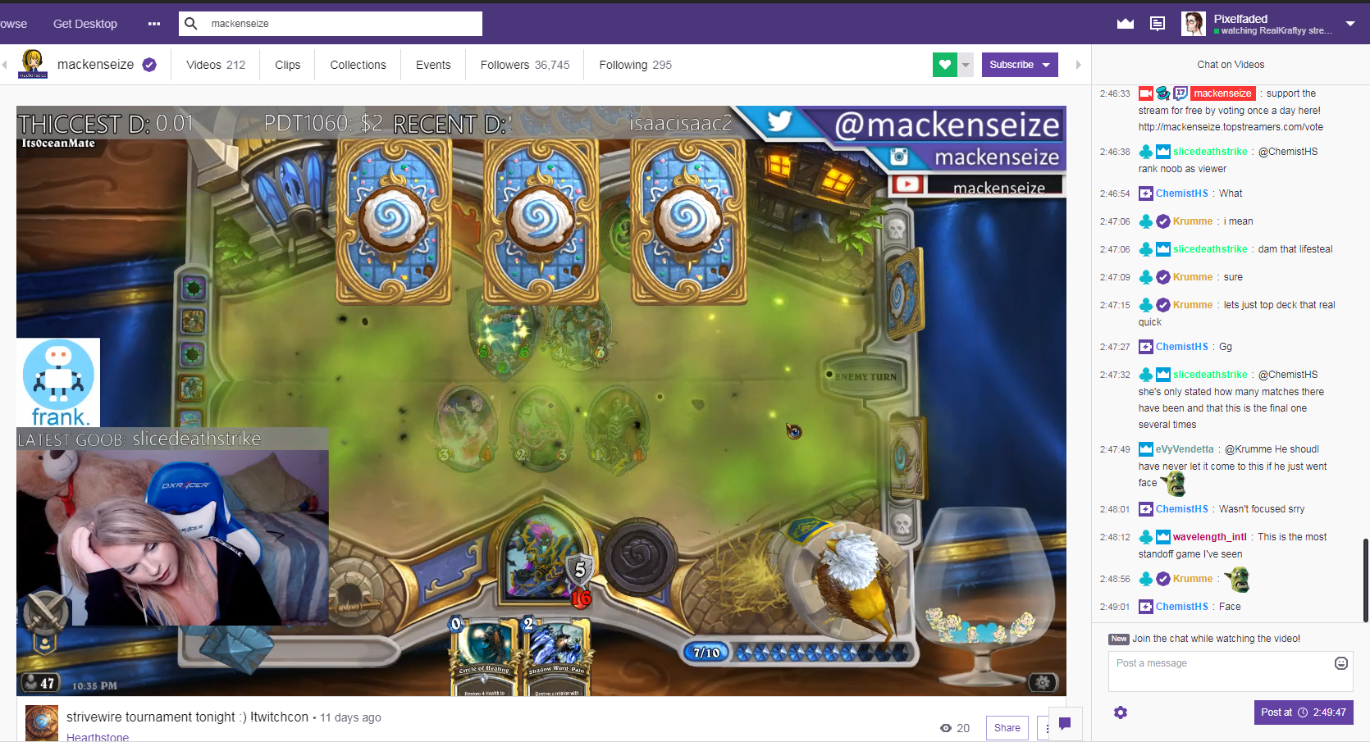
Mis/fitting (when things go wrong)
Health and the body are consciously reflected on by streamers during their performances
**Mackenseize talking about her mom helping her get ready due to her broken arm
**Radderss discussing how tired she is and how she has trouble concentrating on very visually busy games

Slide 25
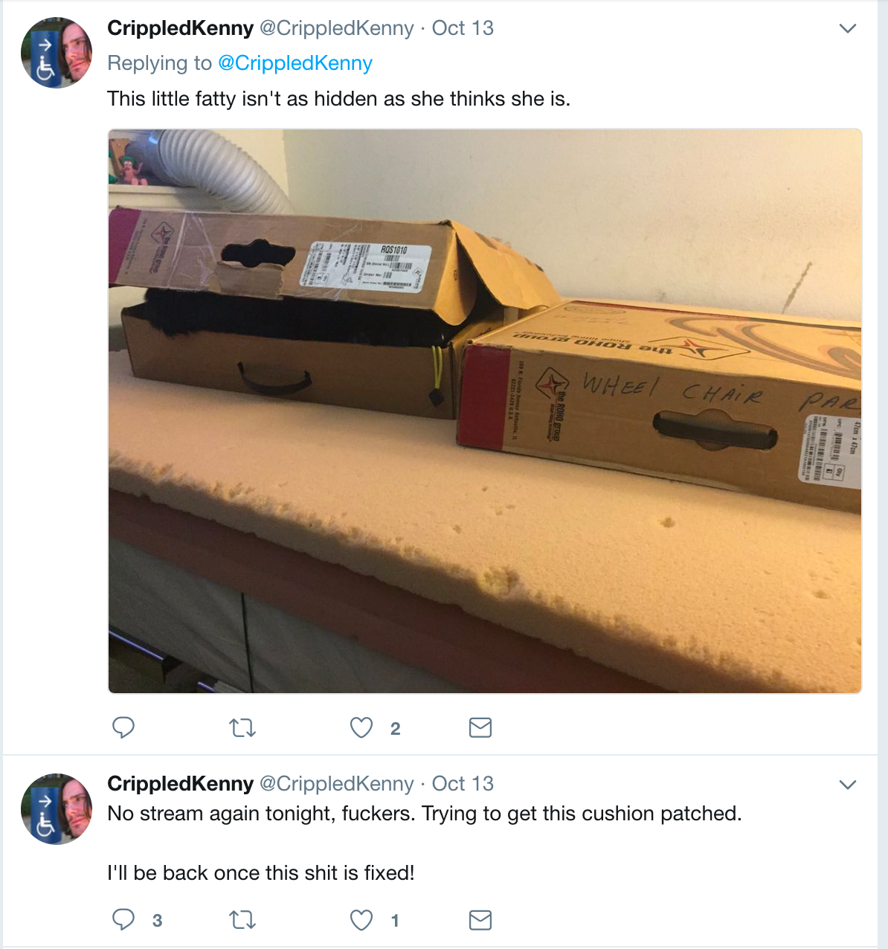
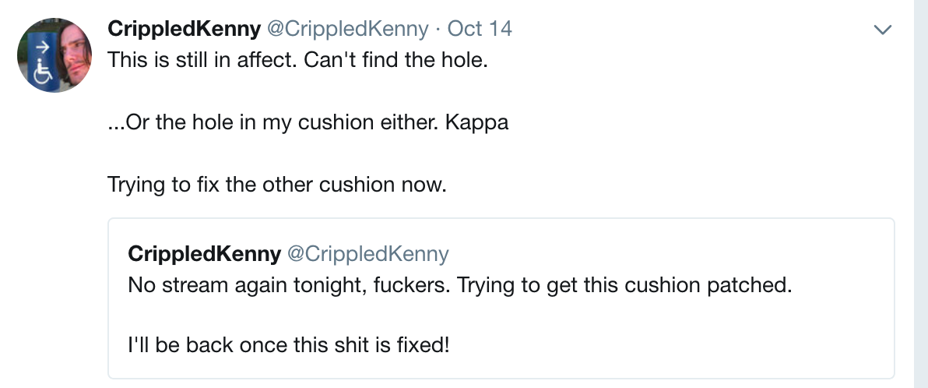
Mis/fitting can also prevent play entirely

Slide 26
Sensory overload
Notes:
Mention Geek and Gamer Girl video - paying bills, etc.

Slide 27
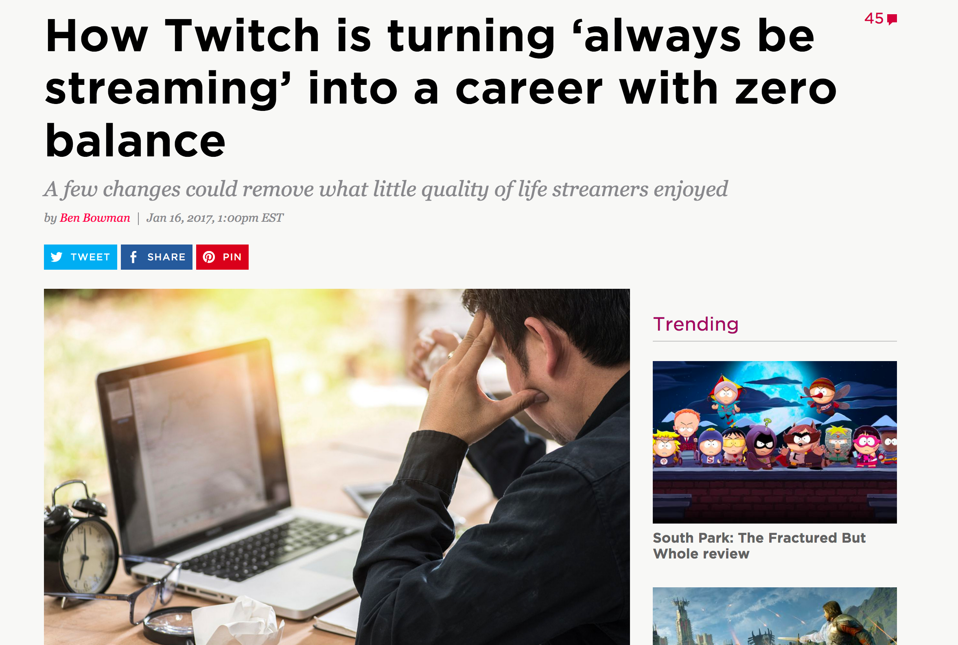
Twitch and a growing culture of mis/fitting
Notes:
‘Always be casting’ - crunching, 12-14 hoursday 7 days/week

Slide 28
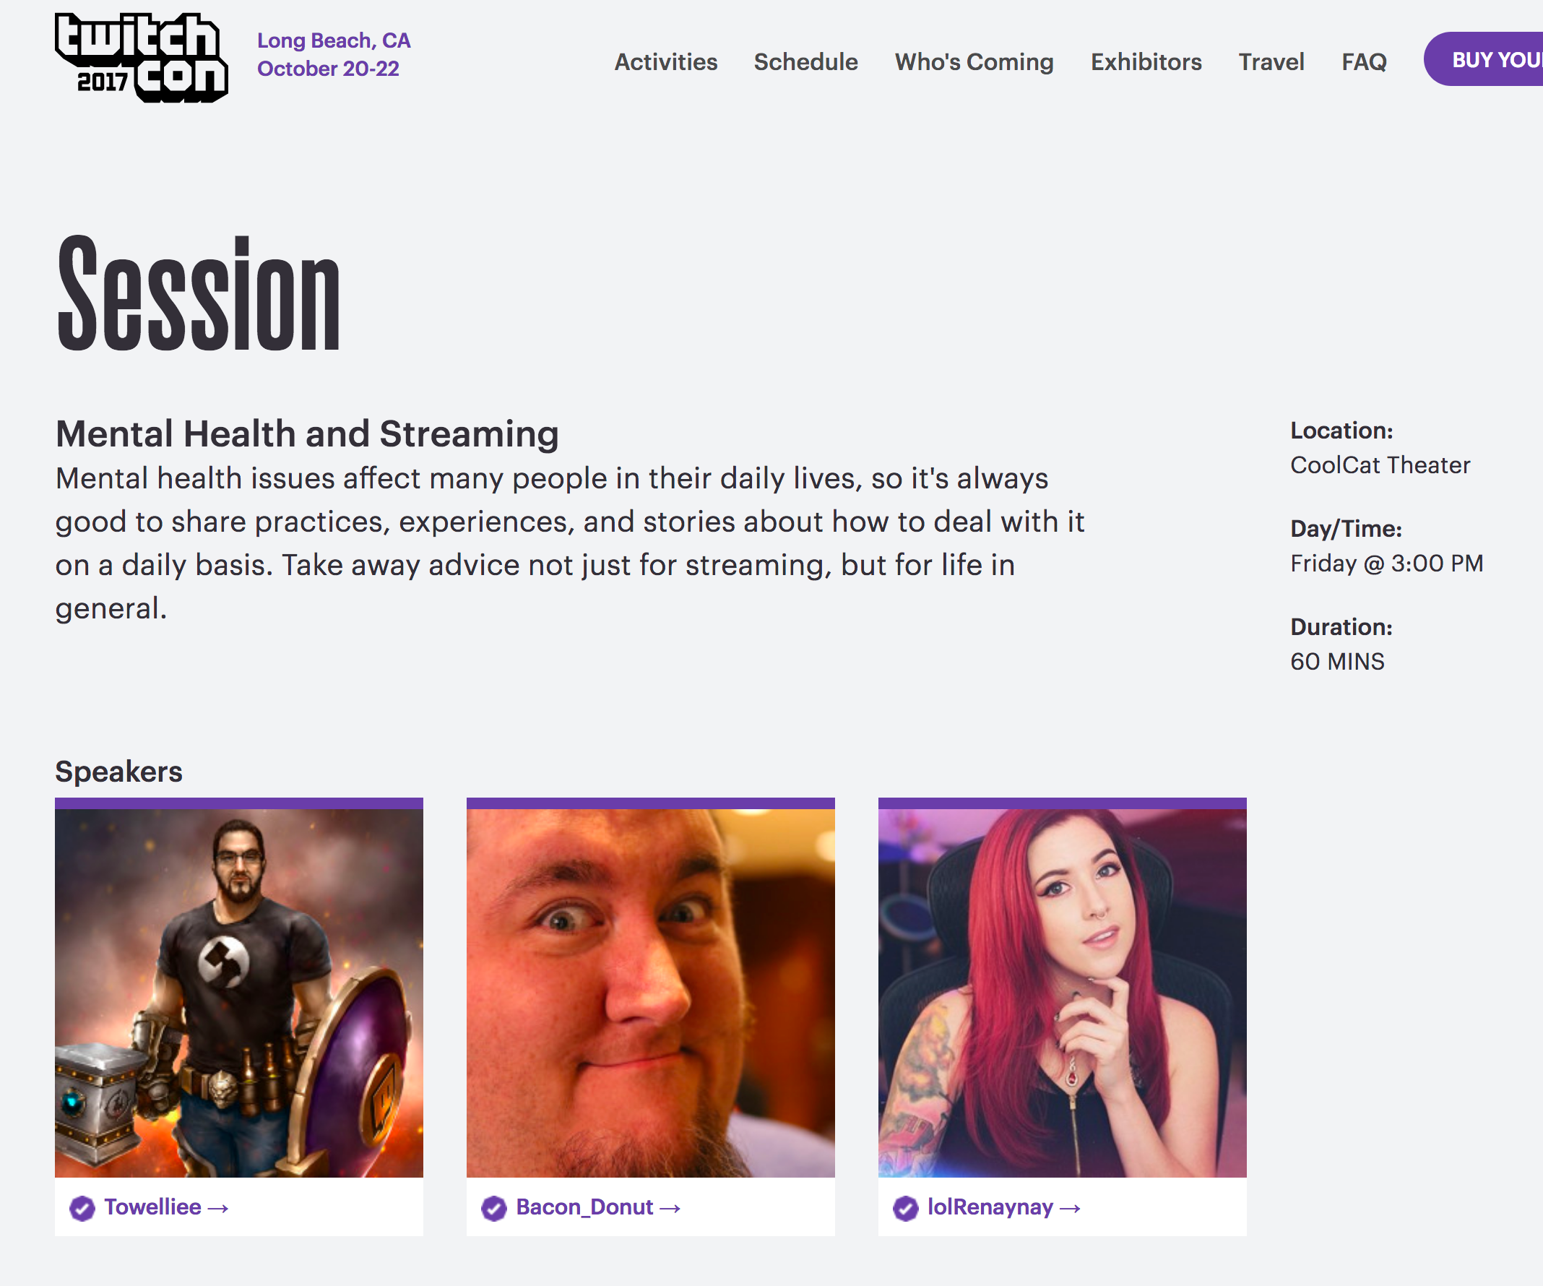

Slide 29
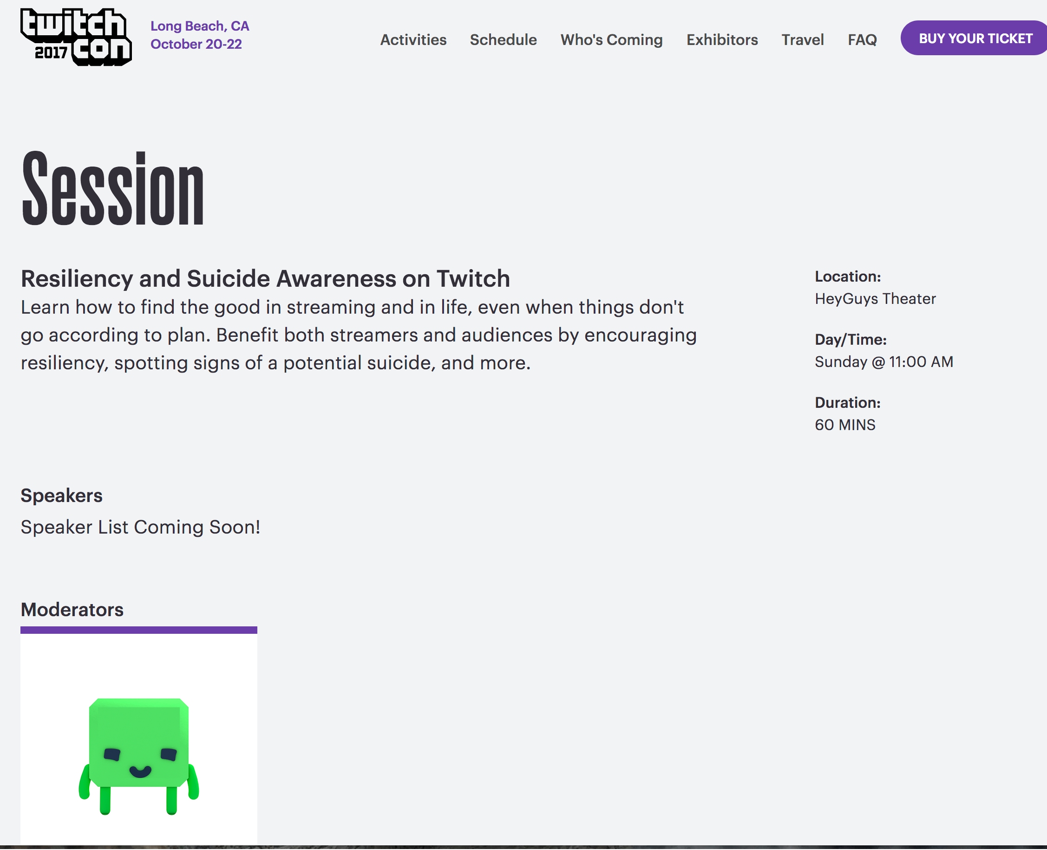

Slide 30
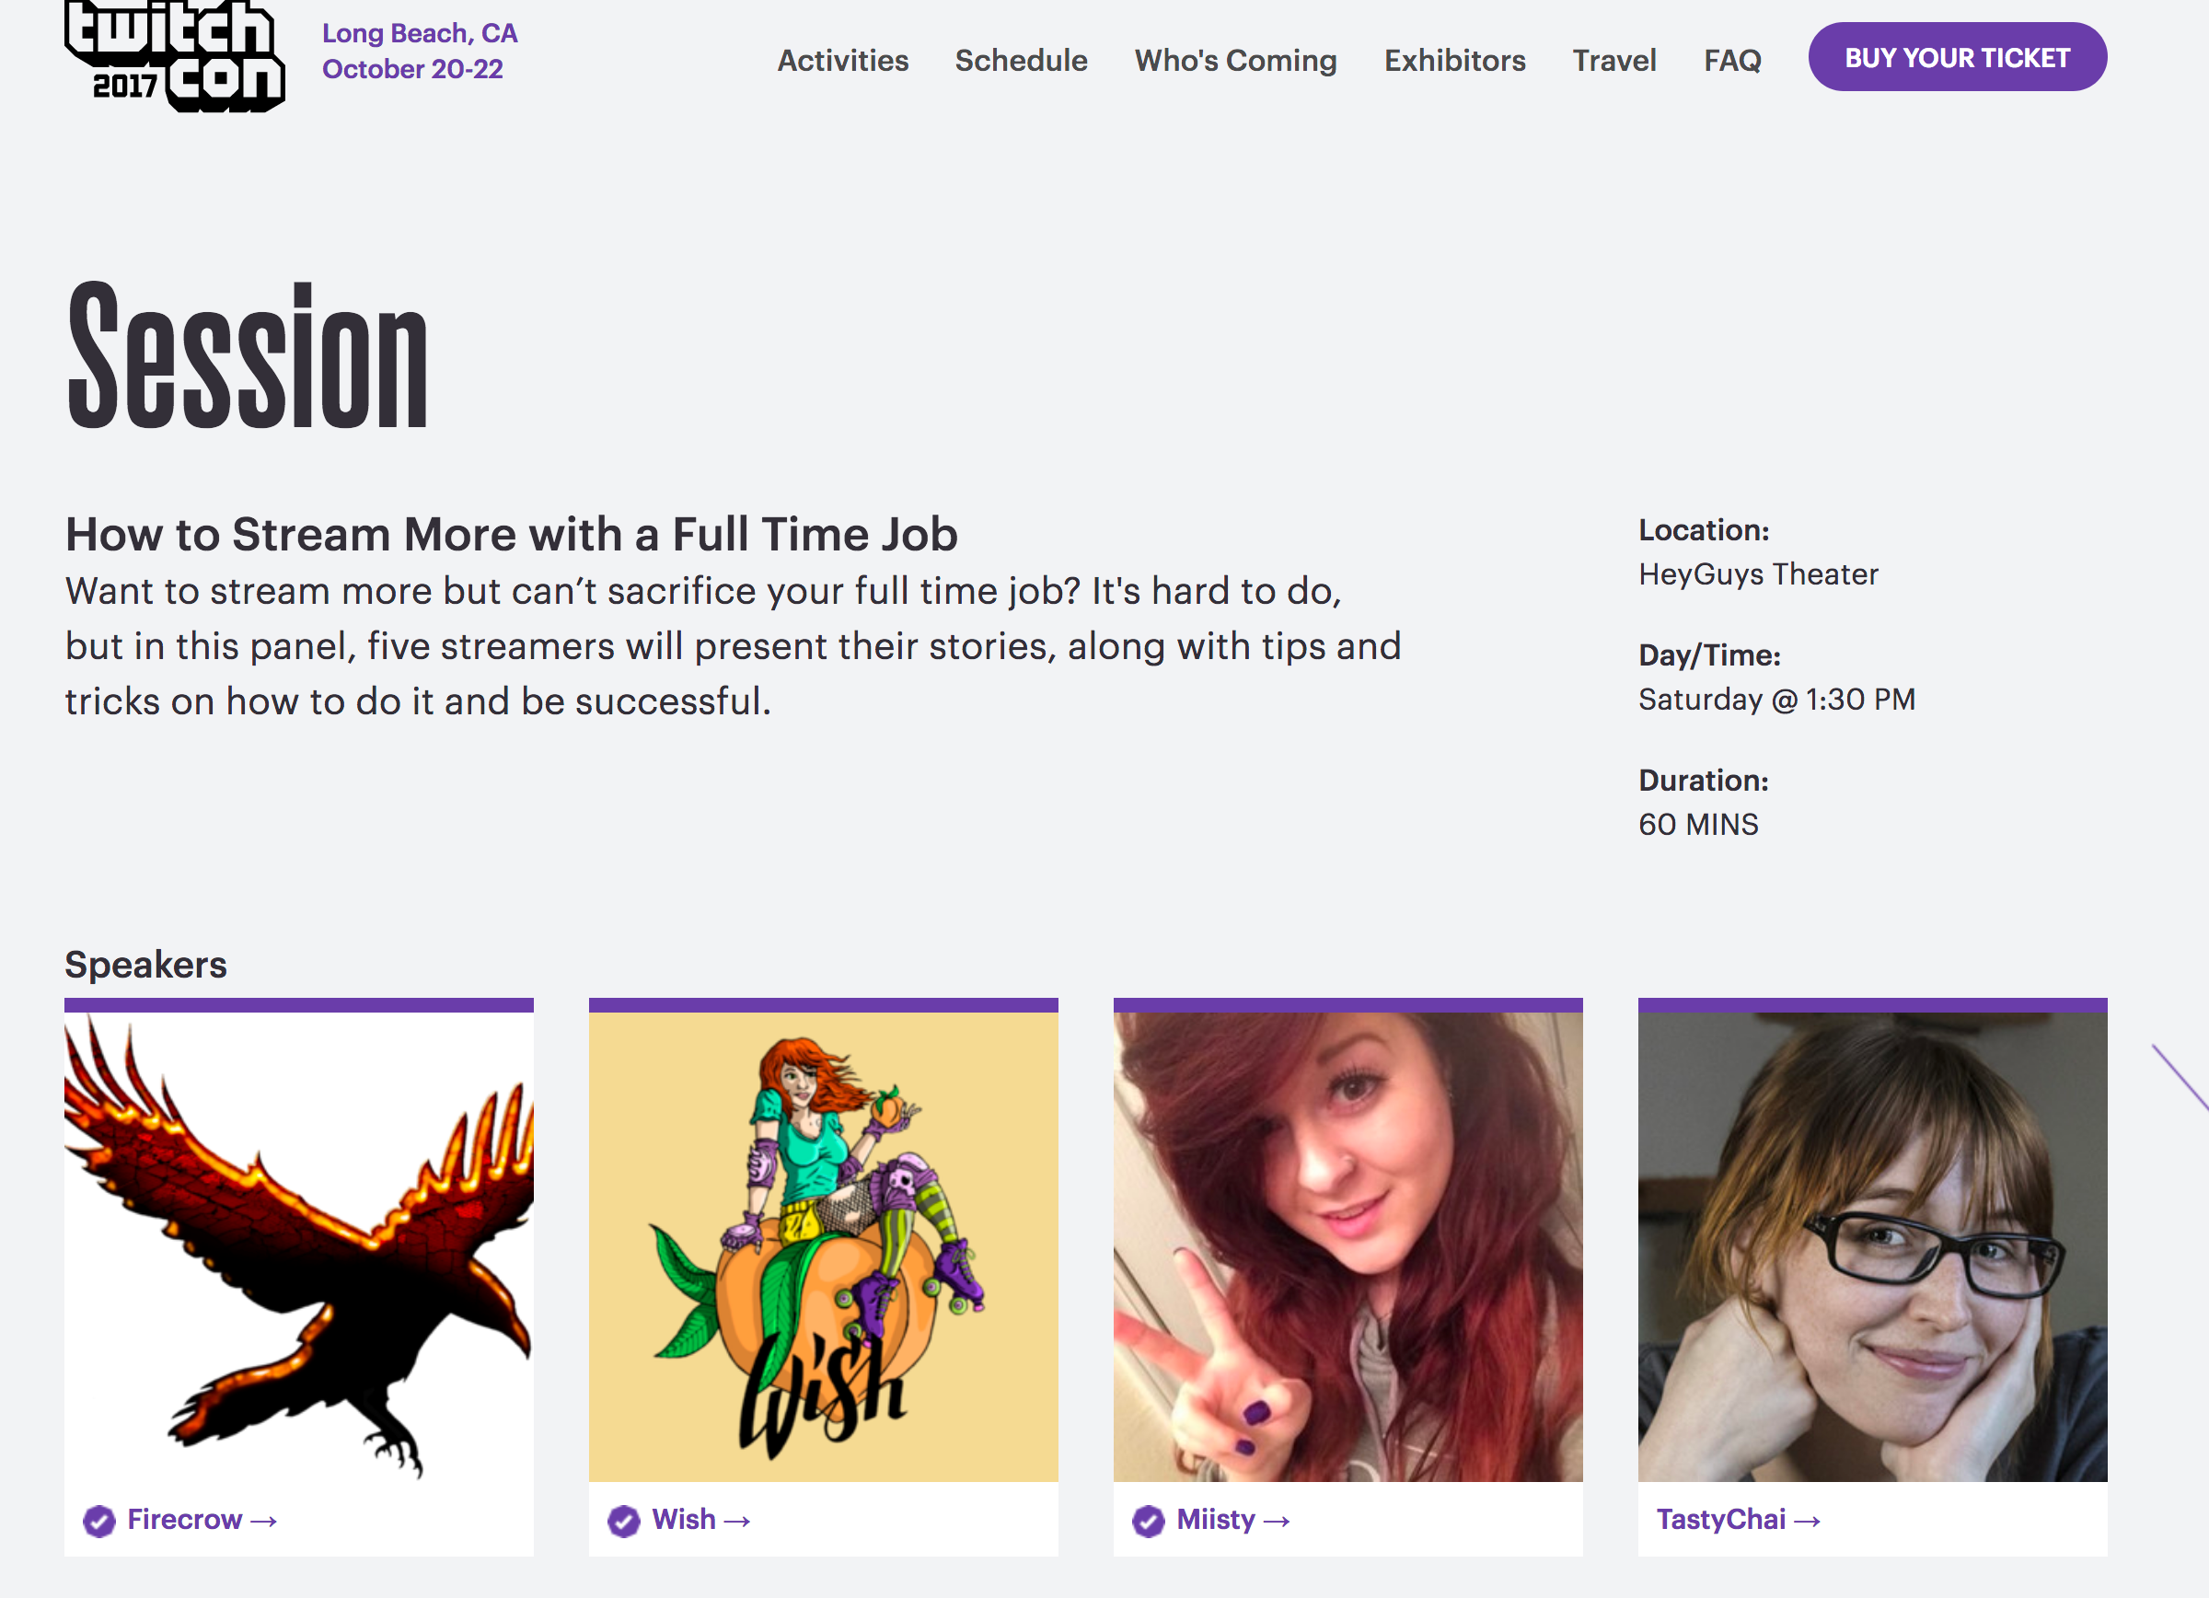
But yet...

Slide 31
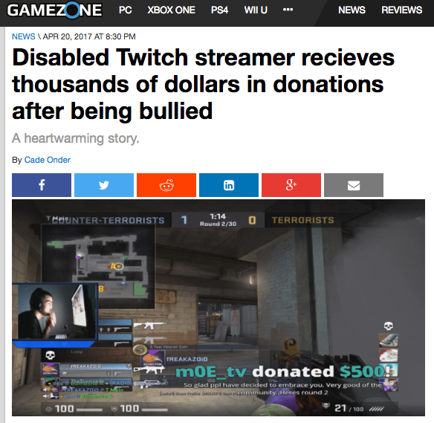
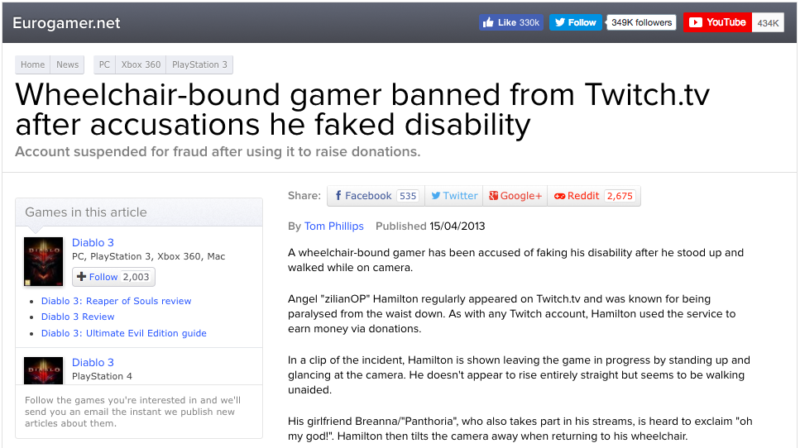
Obsv. 4 Mainstream Media on Players With Disabilities

Slide 32
Conclusions:
There are normative/invisible discourses about what make a real/professional Twitcher that streamers made visible
Streamers with disabilities balance multiple identities as twitch streamers with new norms that go along with being a disabled streamer

Slide 33
100%
Thank you!!
Mia & Roger

